Slide 1
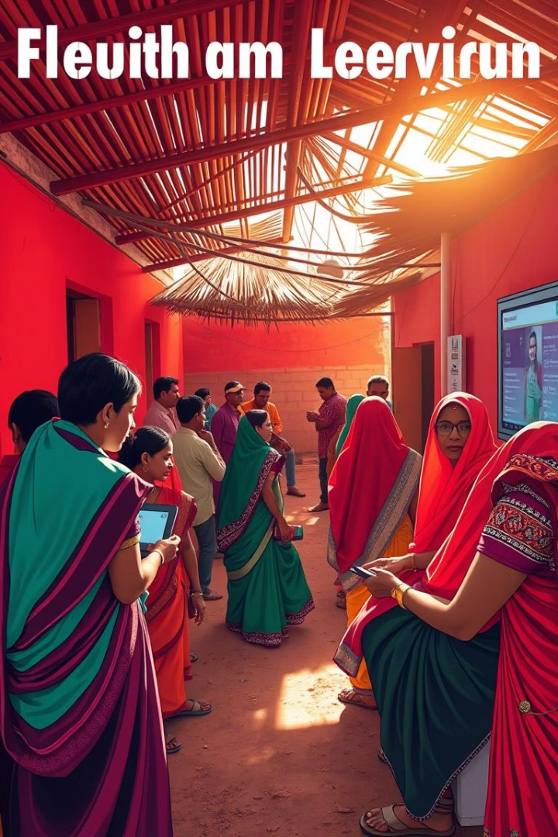
Common Service Centres (CSCs): Bridging the Digital Divide
CSCs are empowering rural India. They offer digital access and services. This transforms India into a digitally inclusive society. Over 400,000 CSCs are now operational nationwide.
Suhana and Shivani
31-05-2025

Slide 2
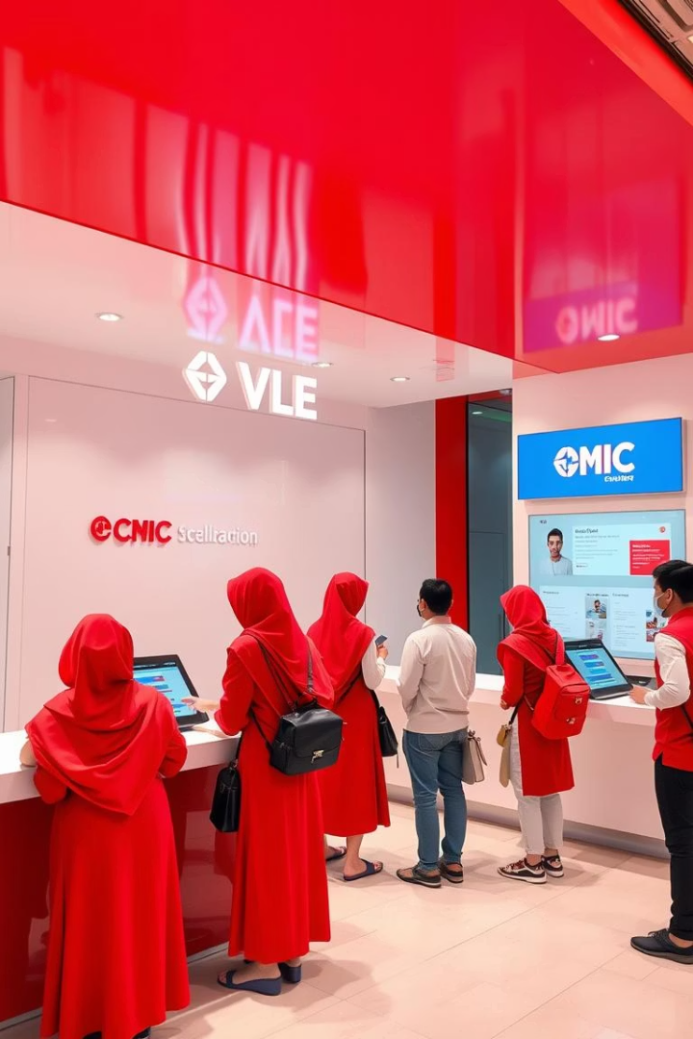



What are Common Service Centres?
ICT-Enabled
PPP Model
VLE-Operated
Front-end service delivery points at the village level.
Public-Private Partnership under Digital India program.
Run by Village Level Entrepreneurs (VLEs).
CSCs focus on e-governance, education, health, and financial services. They aim to provide comprehensive support.

Slide 3
Key Services Offered
G2C Services
Healthcare
Utility Payments
Aadhaar, PAN, passport applications. Government services are accessible.
Telemedicine and diagnostic services. Health access for remote areas.
Electricity, water, phone bills. Convenient bill payment options.
Banking & Insurance
Education & Skill Dev.
Deposits, withdrawals, policies, pensions. Financial inclusion for all.
Digital literacy, vocational training. Empowering future generations.

Slide 4





Challenges and Opportunities
Connectivity Issues
Bridging gaps in remote areas is crucial.
Skill Upgradation
Continuous training for VLEs is essential.
Expanding Services
More offerings and partnerships needed.
Leveraging Tech
AI and blockchain for efficiency gains.
Addressing these challenges unlocks immense opportunities. CSCs can further enhance their impact across India.

Slide 5

Thank You
Common Service Centres are vital for India's digital future. They continue to drive inclusion and progress.

